Slide 1
ITDR Sales Enablement for IDMWorks

Slide 2
Introduction to Verosint
Who We Are:
Verosint is the leader in intelligent Identity Threat Detection and Response (ITDR), providing unified user account security and observability to continuously detect and prevent attacks.
Verosint provides a fast, efficient approach to detect and remediate attacks on user accounts and identity systems.
Verosint provides differentiated AI powered behavioral analytics combined with identity intelligence signals to detect advanced threats and provide continuous protection to organizations and their workforce identities.
What We Do:
2

Slide 3
Introduction to Verosint
Why It Matters:
With Verosint you’re able to:
Protect against the fastest growing and most costly attacks that traditional identity and access management solutions miss
Reduce the time to identify and remediate identity security threats (lower MTTR)
Gain productivity and efficiency with full incident visibility, real-time threat detection, and automated remediation so your team can focus on what matters most
Close staffing and skills gaps by leveraging behavioral analytics, identity intelligence and AI insights to cut through complexity and noise to surface threats
3

Slide 4
User Account Security is broken and unstainable
61%
of all breaches exploit user accounts
User Accounts are Fastest Growing Attack Vector
3.3x
attack frequency increasing annually
$4.8M
average cost of a successful attack in 2024
292 days
average time from detection to remediation

Slide 5
Why is it unsustainable?
CAUSE:
EFFECT:
IAM solutions are being circumvented
Modern cybercriminals have increasingly sophisticated tools & tactics available
Prevention gaps allow attackers to breach, escalate privileges, and move laterally
Prevention alone isn’t stopping attacks
Detection is happening too late
Remediation is too labor intensive

Slide 6
Verosint Provides Real-Time ITDR Capabilities
Unified Observability
Real-time monitoring of user behavior, device activity, and session intelligence
Continuous Threat Detection
AI-driven behavioral analytics and identity intelligence
Real-Time Response
“One-Click" remediation playbooks to stop threats before damage occurs
Credential Stuffing
Account Takeover
Session
Sharing
Stolen Credentials
Brute Force Attacks
MFA Fatigue Attack
Suspicious
IPs
Insider Threats
Unusual Device Use
Impossible Travel
Circadian Rhythm
MFA Location Mismatch

Slide 7
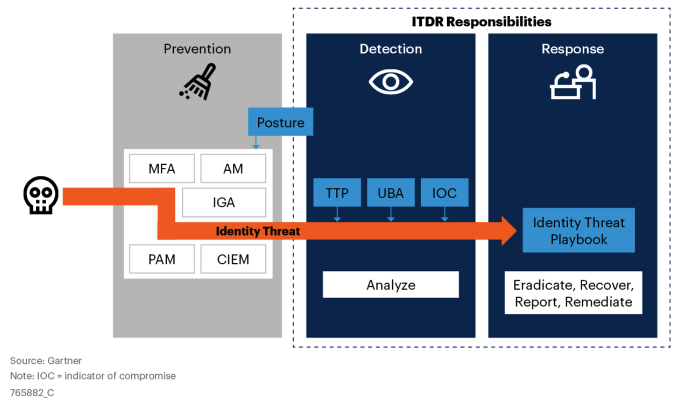
Detect indicators of attack by monitoring for TTPs
Detect the moment an account is compromised by knowing what is normal for every user
#1: Stop Attacks that Circumvent Prevention
Stop Advanced Threats with Verosint’s AI to detect threats that get beyond the prevention layer
Modern cybercriminal tools & tactics circumvent traditional IAM prevention

Slide 8
Find attacks faster & avoid damage with Verosint’s unique focus on real-time account compromise
#2: Detect Fast To Stop Downstream Damage
TYPICAL ATTACK SEQUENCE
Verosint Focus
Typical XDR/EDR Focus
Verosint MTTD: 5 seconds
Avg dwell time to detect & remediate: 292 days
Break out
Initial
Attempt
Initial Access
Lateral Movement
Privilege escalation
Data Exfiltration
Average time to breakout: 62 min
Notes:
Verosint is focused on detecting the moment an account is compromised as opposed to when an endpoint is compromised
Verosint MTTD – From the moment we receive an event, our AI will detect the threat within 5 seconds and make it available to you in the platform.

Slide 9
Gain Efficiency & Productivity with “One Click” Response Playbooks and unparalleled investigative tooling
#3: Simplify Investigation and Remediation
BEFORE VEROSINT
Investigation via log files and manual remediation of an account isn’t cutting it.
WITH VEROSINT
Investigate in minutes, not days, with unparalleled visibility and intelligence that distinguishes Incidents from events
“One Click” built in Threat Response Playbooks to quickly remediate and resolve threats.

Slide 10
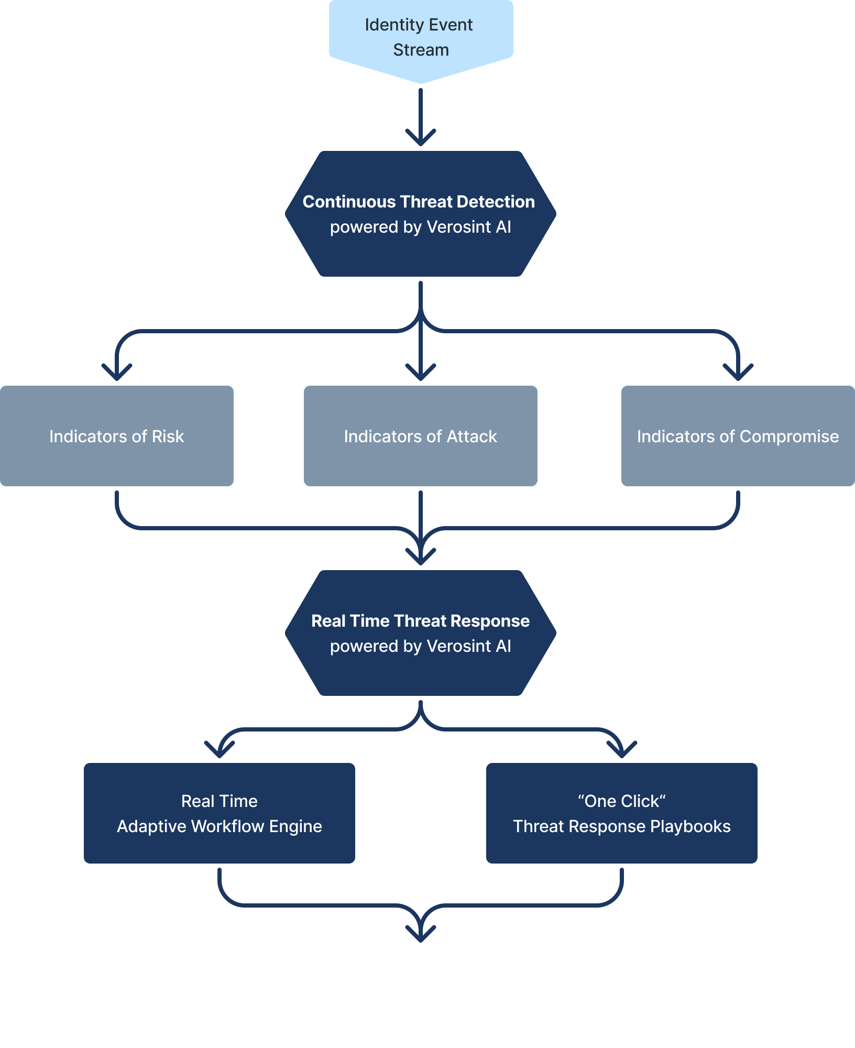
How Verosint Works
and others…
Security Starts With Unified Observability
Prioritize Highest Risks With AI
Notifications to SIEM
Simplify Investigation & Triage
Lightning Fast Remediation
Respond Proactively To New Threats
DETECT
INVESTIGATE
RESPOND
and others…
Notes:
From your identity system, you stream events into Verosint. Those events are processed by our AI that is doing continuous threat detection finding things that are IoR, IoA, or IOC and then you can respond in real time. Either via our adaptive workflow engine which can supercharge your current adaptive authentication or through a one click threat response playbook to suspend accounts.

Slide 11
Customer Success Story
6X ROI in Year 1
“The capabilities we’ve gained using Verosint have been very eye-opening.”
Results after first 90 days:
Blocked over 49,500 attacks
Savings of 25,000 labor hours
65% reduction in account security incidents
Calvin Locklear
Enterprise Solutions Product Manager

Slide 12
Why Sell Verosint?
Rapidly growing market demand for ITDR solutions
Easy integration with existing IAM & SIEM solutions
High-value opportunities across most verticals
Further your success rate in your customers
Provide customers a solution that drives a 70%+ reduction in time/resources to investigate and remediate threats
Immediate impact on security postures
Sell more Advisory, Managed & Professional Services

Slide 13
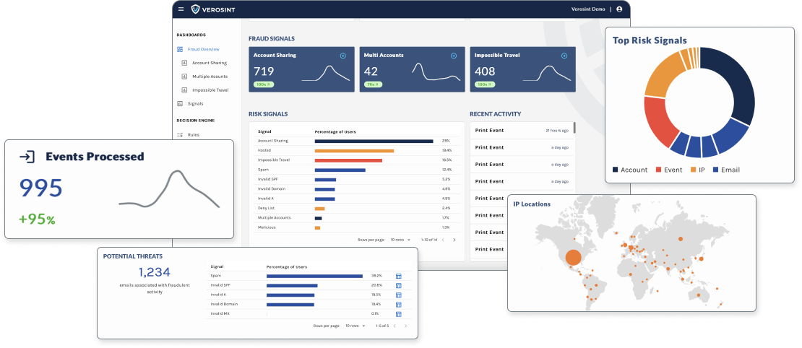
Resources
Activate a free Verosint account today → verosint.com/free
Schedule a demo for key prospects
Engage with Verosint sales for co-selling opportunities
Register Opps at: verosint.com/idmworks
Contact Us: sales@verosint.com or call, text, bat signal me anytime
verosint.com/free
Notes:
It’s fast, free and easy to get started with Verosint.
Immediate Visibility: Real-time discovery of fraud currently hiding in your platform
Actionable Results: Use results to immediately block fraudulent activity moving forward
Fast and Free: Connect in minutes to your authentication and identity mgmt system

Slide 14
Thank You
Activate your free account: verosint.com/free

